Slide 1




Linguistic and Sentiment Analysis of Steve Jobs’ 2005 Stanford Commencement Address
ISTRATI Ion
JARCĂ Marian Cristian

Slide 2


“Stay Hungry, Stay Foolish”
Text Preprocessing
(Cleaning, Removing Stopwords)
Word Frequency Analysis
Word Cloud Visualization
(Standard + Steve Jobs Masked)
Sentiment Analysis
(Emotion & Tone Evaluation)
Graphical Representation
Sentiment Variation & Insights
Load Speech Transcript
Start
Conclusion
💬 Why analyse this speech?
• One of the most influential speeches in modern history
• Focuses on passion, failure, and resilience
• Inspires leaders, entrepreneurs, and students
🎯 Our goal:
• Explore word usage, frequency, and sentiment
• Understand the emotional and linguistic impact

Slide 3
Methodology Overview
Text Preprocessing
(Cleaning, Removing Stopwords)
Word Frequency Analysis
Word Cloud Visualization
(Standard + Steve Jobs Masked)
Sentiment Analysis
(Emotion & Tone Evaluation)
Graphical Representation
Sentiment Variation & Insights
Load Speech Transcript
Start
Conclusion
Word Frequency Analysis
Jobs avoids complex jargon, making the speech relatable
“love”
“trust”
“life”
“time”
Emotional & personal language enhances impact

Slide 4
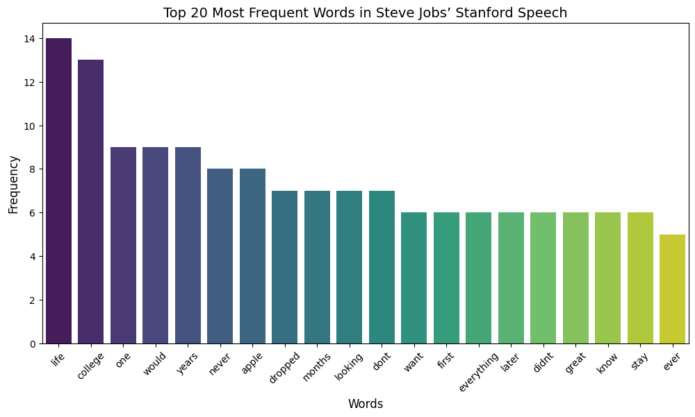
Word Frequency Analysis
Jobs avoids complex jargon, making the speech relatable
“love”
“trust”
“life”
“time”
Emotional & personal language enhances impact

Slide 5
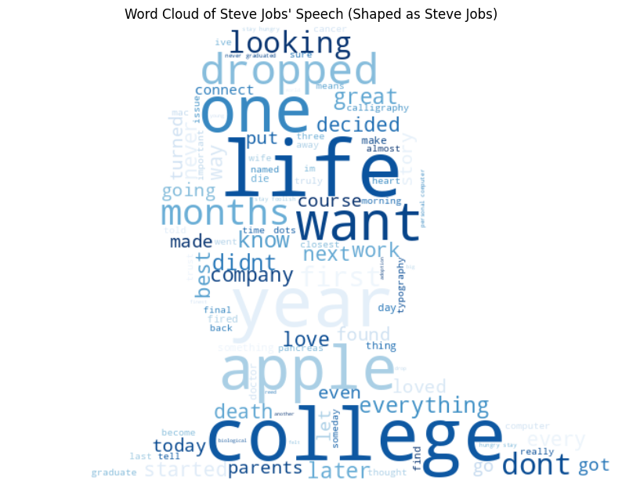
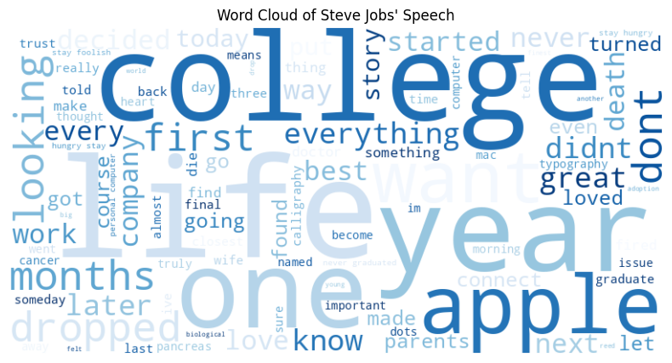

Slide 6
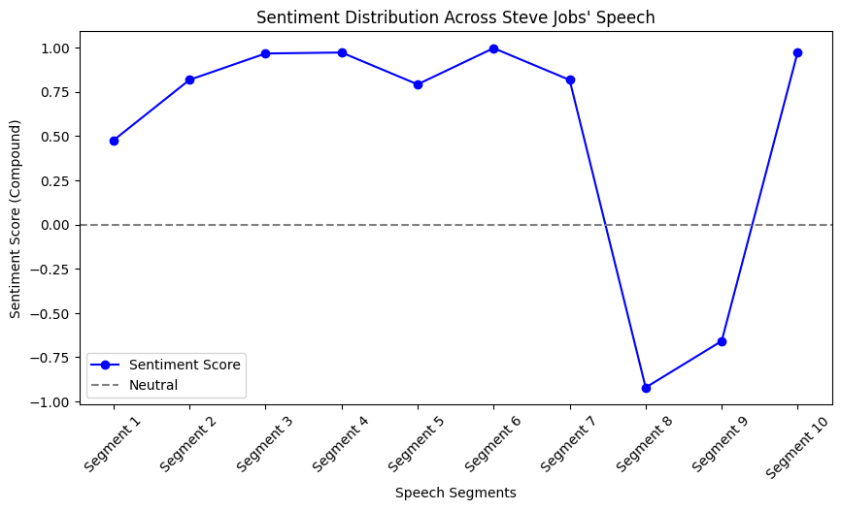

Slide 7

Sentiment Analysis Results
What makes this speech powerful?
• Emotion-driven storytelling
• Strategic word choice
• Authenticity and relatability
Jobs uses language and emotion strategically to leave a lasting impact on his audience.
📊 Sentiment Trends in the Speech
🔼 Peaks: Inspiration & motivation (e.g., “Follow your heart”)
🔽 Dips: Personal struggles (e.g., cancer diagnosis, failure)
💡 Balanced storytelling makes the speech more impactful

Slide 8
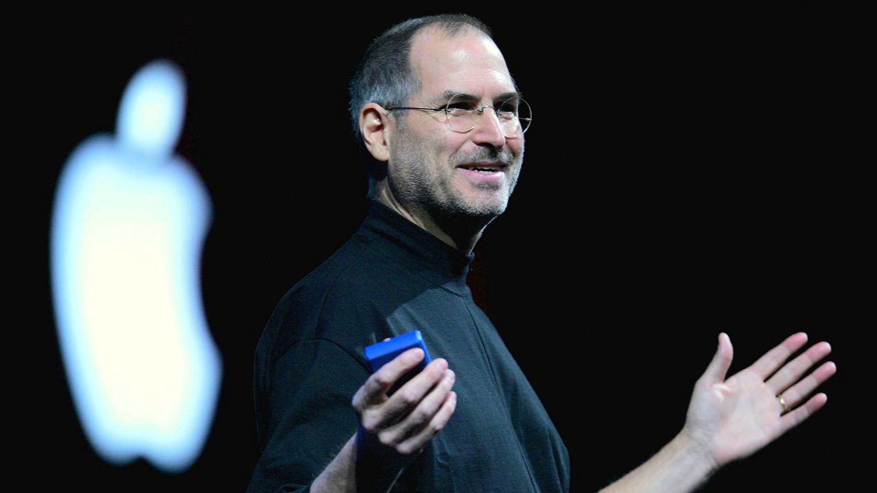
What makes this speech powerful?
• Emotion-driven storytelling
• Strategic word choice
• Authenticity and relatability
Jobs uses language and emotion strategically to leave a lasting impact on his audience.

Slide 9
“Your time is limited, so don’t waste it living someone else’s life.”

